Slide 1
Pls 2000 power & politics
IDEOLOGIES OF THE LEFT:
ANARCHISM, COMMUNISM & SOCIALISM

Slide 2
IDEOLOGIES OF THE LEFT: ANARCHISM, COMMUNISM & SOCIALISM
I. MARXISM
II. SOCIALISMS
III. ANARCHISM
TERMS TO KNOW
Marxism Leninism Evolutionary Socialism
Communism Democratic socialism False Consciousness
Anarchism Vanguard Social Democracy
Bourgeoisie Proletariat Antifa
CHOP/CHAZ

Slide 3
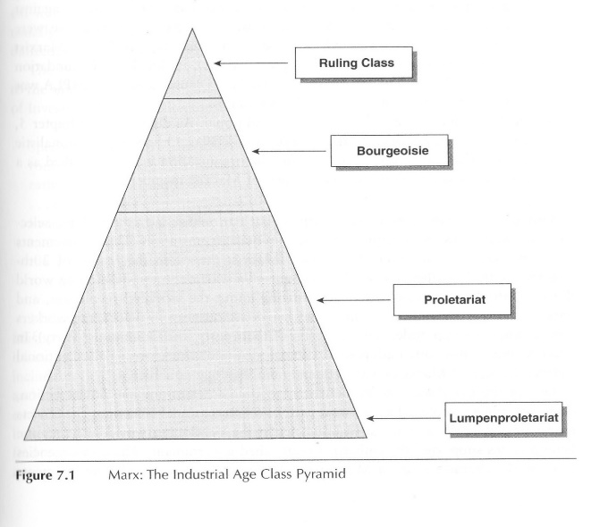
i. marxism
Critique of Liberalism: “What does liberalism achieve? ‘Man is not freed from religion; he receives freedom of religion. He is not freed from property; he receives freedom of property. He is not freed from the egoism of trade; he receives freedom to trade’ (Marx, 2000, p. 63).
Materialism and Economic Determinism: values and conflict come from economic structures and conditions: Capitalist industrialization exploits labor class and Creates inequality:
Scientific dialectical progression of history will replace capitalist structures and their supporters with a just system where classes merge and the state withers away
Revolutionary or evolutionary? Leninism and early Marxism: the owners will not cede willingly so “working class” will have to take it.
“evolutionary socialism” (p.124): suffrage as a means for socialism to win through the enfranchisement of the working class in a democracy
Populist or vanguard? Industrial (or peasant) uprising vs. Leninism’s elite revolutionary coup for emancipation and set up a dictatorship of the proletariat (“democratic in its own way”)

Slide 4
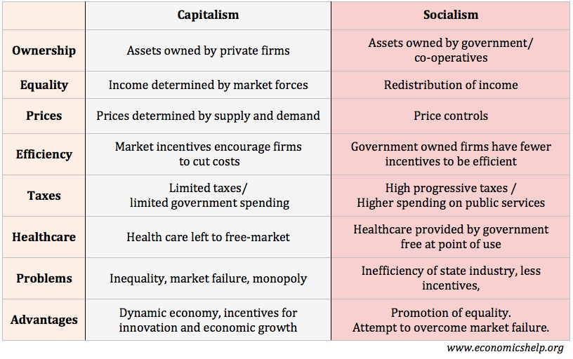


iI. socialisms
Core Values of Socialism
Optimists about human nature (p.125)
Equality of Outcome (p.127): inequalities not due to effort but social structures, thus social structures can change to improve
Community & Cooperation: collective over individual goals, motives and interests (p.127)
“We are not mere selves, but selves in a situation, in a society...no longer a merely selfish self, but a self constituted by its existence in society...Society does not consist of individuals; it expresses the sum of connections and relationships in which individuals find themselves” (Anderson 2014)
Communism
The Theory: the state withers away and communal harmony exists for all, contributing each according to his ability to each according to his need
The Reality: so far, all declared communist parties and states have retained authoritarian state control in the name of the working class to run a planned, command economy and provide services to its people (Marxist-Leninism’s dictatorship of the proletariat)

Slide 5
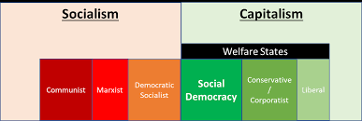
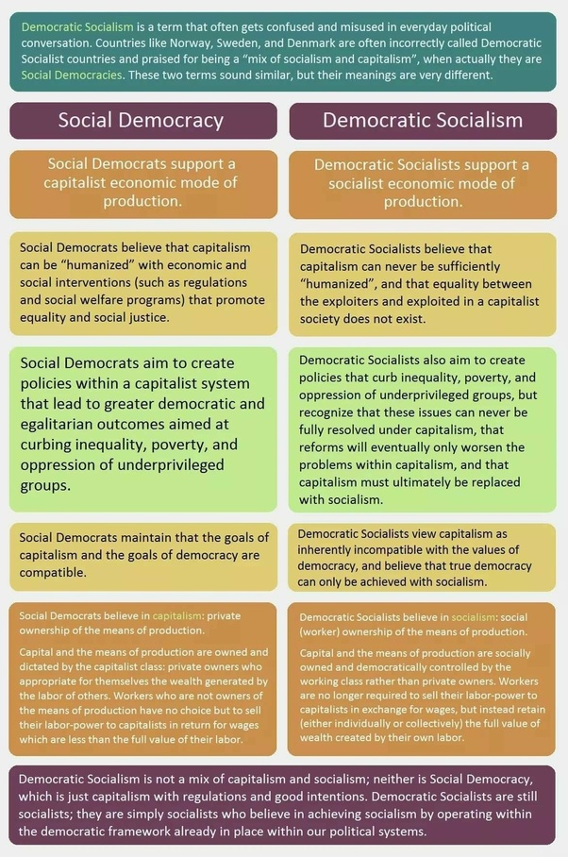
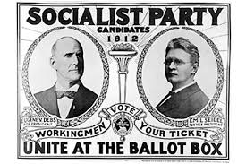


DEMOCRATIC socialism & social democracy
Socialism: “a system of government that provides citizens with health insurance, retirement support, and access to free higher education.”
Plus individual liberties that Communists called “bourgeois”(EJ Dionne)
Democratic socialists “committed to systemic transformation of the economy from capitalism to socialism, whereas Social democracy is concerned with reforming and humanizing capitalism through the framework of a welfare state.”
Socialism in the USA
1912: socialists held 1200 metro offices (79 mayors) & Eugene Debs wins 6% of the popular vote for Pres
Red Scare x New Deal Liberalism: decline in American socialism
End of Cold War x 2008 Great Recession/2020 Covid economic upheaval: it’s back
Bernie 2016 & 2020
https://jclibrary.info/wp-content/uploads/2020_Programs-Adult/Do-Social-Democracies-Work-Lecture.pdf
https://www.quora.com/Is-there-a-difference-between-social-democracy-and-democratic-socialism
Notes:
Democratic socialism is taking socialism and trying to make it more democratic
Social democracy is trying to reform capitalism

Slide 6
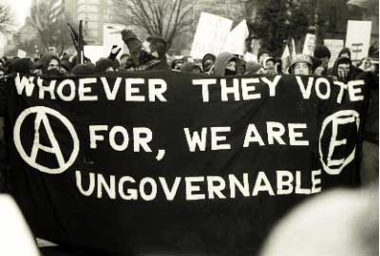
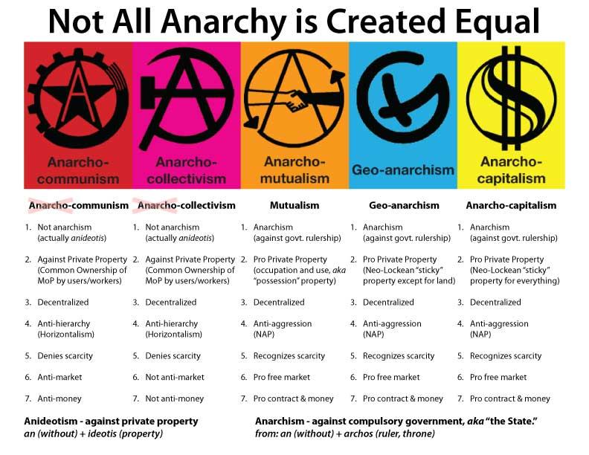
iII. anarchism
The state is corrupting: “Authority is the root cause of all our misery”
“What we intend to put in place of the State? …Nothing whatever!” (1895 Anarchist Manifesto)
Advocates stateless society where individuals cooperate voluntarily to create progress and justice
Optimistic about human nature: ‘recognition of the force that is borrowed by each man from the practice of mutual aid; of the close dependency of everyone's happiness upon the happiness of all; of the sense of justice, or equity, which brings the individual to consider the rights of every other… equal to his own. Upon this broad, necessary foundation higher moral feelings are developed.’ (Kropotkin)
Anarchism(s):
Anarcho-Capitalism (Ancap): free-market private property advocates
Anarch0-Socialism: “liberty without socialism is injustice; socialism without liberty is slavery and brutality” (Bakunin)
Existentialist: acting according to our own values in a universe of meaninglessness: destinies not dependent on economic or social conditions
Decentralization and action to make “dominant forces renounce their grip …to overcome hegemonic, hierarchical and oppressive” society - “only individuals are sovereign” (Sartre)
Nihilist selfishness or Humanist affirmation of agreed responsibilities
https://iai.tv/articles/sartres-anarchist-philosophy-auid-1242
https://www.cato.org/commentary/liberaltarians
http://dwardmac.pitzer.edu/Anarchist_Archives/bright/nettlau/manifesto.html
https://warontherocks.com/2020/06/what-antifa-is-what-it-isnt-and-why-it-matters/
https://www.theconservativehippie.com/2020/10/anarcho-capitalism-and-geopolitics-as-defined-by-tom-luongo/

Slide 7
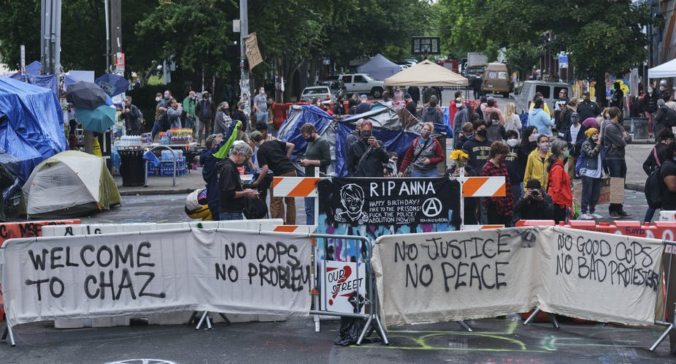
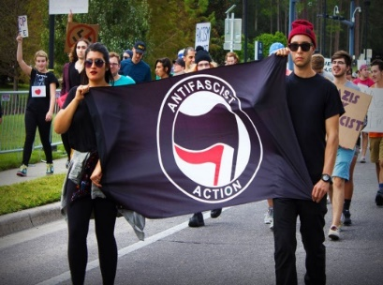
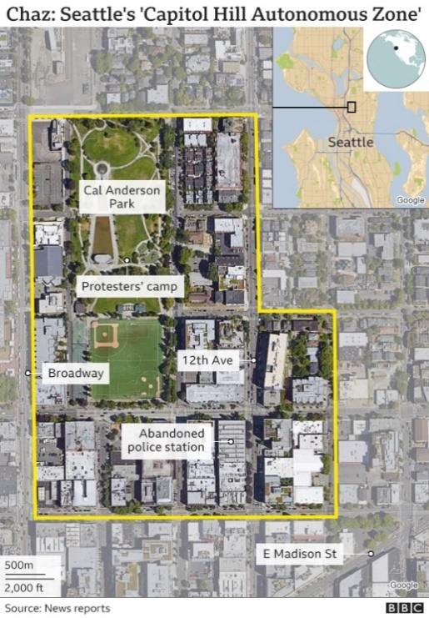
“Freedom and Equality” without the State?
Capitol Hill Autonomous Zones (Occupied Protest/Organized Protest)
It’s Going Down: digital community from anarchist, anti-fascist, autonomous anti-capitalist and anti-colonial movements. Our mission is to provide a …platform to publicize and promote revolutionary theory and action.”
4 Shootings and the end of the experiment:
Fire Dept had not entered the zone because procedure is to wait for the Police.
When Police officers did enter, they encountered hostility
No suspects identified in the cases, and Police were looking for witnesses.
ANTIFA: short for anti-fascist — a loose network of groups and individuals who coordinate activism in different areas within and outside the US.
“beliefs associated with left end of the spectrum: anarchism, communism, socialism, anti-Racism”
Like-minded supporters coordinate and make local decisions by “Direct democracy” group consensus
https://thedispatch.com/p/the-origins-of-defund-the-police
https://www.nytimes.com/2020/06/22/us/seattle-autonomous-zone-chop-shootings.html
https://nypost.com/2020/06/14/clueless-in-seattle-protesters-debate-on-name-for-cop-free-zone/
https://itsgoingdown.org/get-in-the-zone/

